Slide 1
Week 9 Live Session
Wendy Christensen, Ph.D.
COMP 4442
Spring 2021

Slide 2
Agenda
Course logistics + project review
Tips for preparing a short presentation
Problem Set 8 questions
Survival analysis overview
Final exam

Slide 3
Upcoming deadlines
Problem Set 8 (last one!): Friday, 5/28
Participation 9: Sunday, 5/30
Presentation materials: Immediately after you/your group’s presentation. Each person should upload their materials to Final Project - Presentation.
Project paper: Sunday, 6/6
Final exam: Wednesday, 6/9
Extra credit submissions (100% optional): Wednesday, 6/9

Slide 4
Project presentation guidelines
As a presenter...
The project presentation is expected to scale per person presenting: 5-7 minutes per person
All groups will need to cover each aspect of the rubric, but the amount of detail expected will be scaled according to the number of people in the group.
Whether giving an individual or a group presentation, timed rehearsal of your talk will almost certainly be necessary to meet the rubric requirements.
You/your group will field at least one question, probably 2-3.

Slide 5
Project presentation guidelines
As an audience member…
You will need to formulate questions to presenters. Unless important information is omitted by the presenters, the questions you formulate should be specific to the talk (i.e., not questions you could ask to any group, such as “what was your sample size?”).
You will complete a short writing exercise after each presentation.
You will submit these writing exercises to me after the session is complete. This will be your Week 10 participation exercise, so please submit the document to the Week 10 participation folder

Slide 6
Aside: How I put together a 5-minute talk
For my lightning talk at SatRDay LA 2019 (https://youtu.be/YEnPHmV_e5o):
I decided what my key message was and any vital supporting information needed the audience needed to know to understand.
Wrote a point-by-point outline of my talk and how long I wanted to spend on each point.
Created slides/visual aids to support each point.
Gave the talk seated and at my desk about 5 times to identify places where I needed to work on how I said things AND how I wanted to start every slide.
Gave the talk (standing next to my computer in an empty room with timer running) 10-20 more times to improve the flow of the talk.
The moral: Do not give your presentation for the first time in front of the class - practice is key!

Slide 7
Project paper guidelines
The max length for the paper is 6 pages and should be written as a manuscript; no outlines or notebook-style documents (i.e., little, if any, code shown in your manuscript).
The font should be readable (no less than 10 pt), and the lines may be single- or double-spaced.
The executive summary/abstract should probably be no more than 300 words and should contain a summary of the research question, references the method used, and your conclusions about the research question.
How to split up sections is up to you, but I expect your choices of headings/subheadings/paragraphs to improve the organizational structure of your paper.
Figures and tables don’t count toward the page limit, and you may put them at the end of the manuscript or in-text (but make sure you’re under the page limit with these omitted).
Please submit your code in a separate .rmd file and your data set (if possible).

Slide 8
Problem Set 8 questions?

Slide 9
Foundational Ideas for Survival Analysis

Slide 10
Time-to-event
There are instances when the outcome of interest is the time to the occurrence of some kind of event (“time-to-event”). Some of the earliest examples of such outcomes relate to mortality (“time-to-death”), but there are many potential examples.
In the chat, share a non-death example of a time-to-event outcome.

Slide 11
Time-to-event
There are instances when the outcome of interest is the time to the occurrence of some kind of event (“time-to-event”). Some of the most common examples of such outcomes relate to mortality (“time-to-death”), but there are many potential examples.
Ones I’ve seen that don’t involve death include:
Time to cessation of therapy for adolescents with eating disorders
Time to the initiation of sexual behavior in adolescents
Time to relapse of alcohol use after an in-patient treatment stay
Time to graduation among first-generation college students

Slide 12
Modeling time-to-event outcomes
Much like count data, time-to-event data isn’t well-suited for multiple regression for several reasons.
These outcomes are often very non-normal, even in homogenous groups (e.g., the “bathtub” function; event occurrence is high at first, drops and stays low for awhile, then rapidly increases again).
Time-to-event will always be positive, but regression can result in negative predicted values (similar to the problem with counts)
Time-to-event data is prone to “censoring”, which we’ll discuss shortly.

Slide 13
Survival analysis
Survival analysis is well-suited for time-to-event data and is used to answer questions about whether events occur and/or when events occur.
Using survival analysis to model event occurrence requires clearly defining three things:
What constitutes an event occurrence
When time begins (i.e., when the observation window starts, before which the event cannot have already occurred)
A meaningful metric of time (which can be discrete or continuous)

Slide 14
Survival analysis
Define these three things for the time-to-event outcome you put into the chat earlier and write your answers to these in the chat.
What constitutes an event occurrence
When time begins (i.e., when the observation window starts, before which the event cannot have already occurred)
A meaningful metric of passing time (which can be discrete or continuous)

Slide 15
Survival analysis - censoring
Censoring refers to a situation where the event is not observed for an individual during the observation window. It has two potential causes:
The event will never happen to some individuals, so no length of observation window would capture the event occurrence.
The event will happen to some individuals sometime after the observation window, so the observation window was inadequate to capture the event.
Censoring can be further divided into right censoring and left censoring, which refers to which “side” of the observation window the censoring occurs.

Slide 16
Survival analysis - right and left
“Right” censoring occurs when the time-to-event is unknown because the event wasn’t observed during the observation period. This is by far the most common type of censoring and is almost always what is meant when the term is used.
“Left” censoring occurs when an the time-to-event is unknown because the event already happened before the beginning of the observation period. This is very difficult to handle through the model, so the most common solutions are to either exclude these observations or more carefully define the beginning of the observation period (e.g., with repeating outcomes, start after the last occurance)

Slide 17
Survival analysis - censoring as information
Censoring can be further divided into two types: non-informative censoring and informative censoring. This division is especially salient when the censoring happens because of attrition (i.e., participants prematurely drop-out of the study) or because the end of the event window has been reached.
Non-informative censoring refers to censoring caused by factors not related to the risk of event occurrence. This is important because, if this is true, that means that those subjects would have otherwise remained in the study, so the remaining subjects are representative of the whole sample.
This is similar to the idea of “missing at random” from missing data literature.

Slide 18
Survival analysis - censoring as information
Censoring caused by factors related to the risk of event occurrence is considered informative censoring. That is, there exist systematic differences between those whose outcomes are censored and those whose outcomes are not censored. Thus, the remaining subjects are not representative of the whole sample.
This is similar to the idea of “missing not at random” in missing data methods.
Example: If a person who relapses into alcohol abuse is more likely to stop responding, the censoring is related to the risk of event occurrence.

Slide 19
The hazard function
A hazard function is the conditional probability that a given individual will experience the event in a given time period, given that the individual did not experience the event in any earlier time period. For example, the probability of a a 60-year old person dying is conditional on that person having not died as an infant.
Hazard functions can increase or decrease across the observation window. For example, the “bathtub” hazard function is high at the beginning, low in the middle, and returns to being high at the end. This corresponds to the probability of the event occurring for individuals at a given time who have not yet experienced the event.

Slide 20
The survival/survivor function
The survival function is the cumulative probability that an individual will not experience the event up to given time period. Thus, at the beginning of the observation window, the value of this function is equal to 1 because no one has experienced the event yet. If it reaches zero before the end of the observation window, then everyone will have experienced the event.
Unlike the hazard function, this function can only remain flat or decrease across the observation window; it cannot increase. What would an increase imply?
The slope of the survival function is related to the hazard function. When hazard is high, survival decreases quickly; when hazard is low, survival decreases slowly.

Slide 21
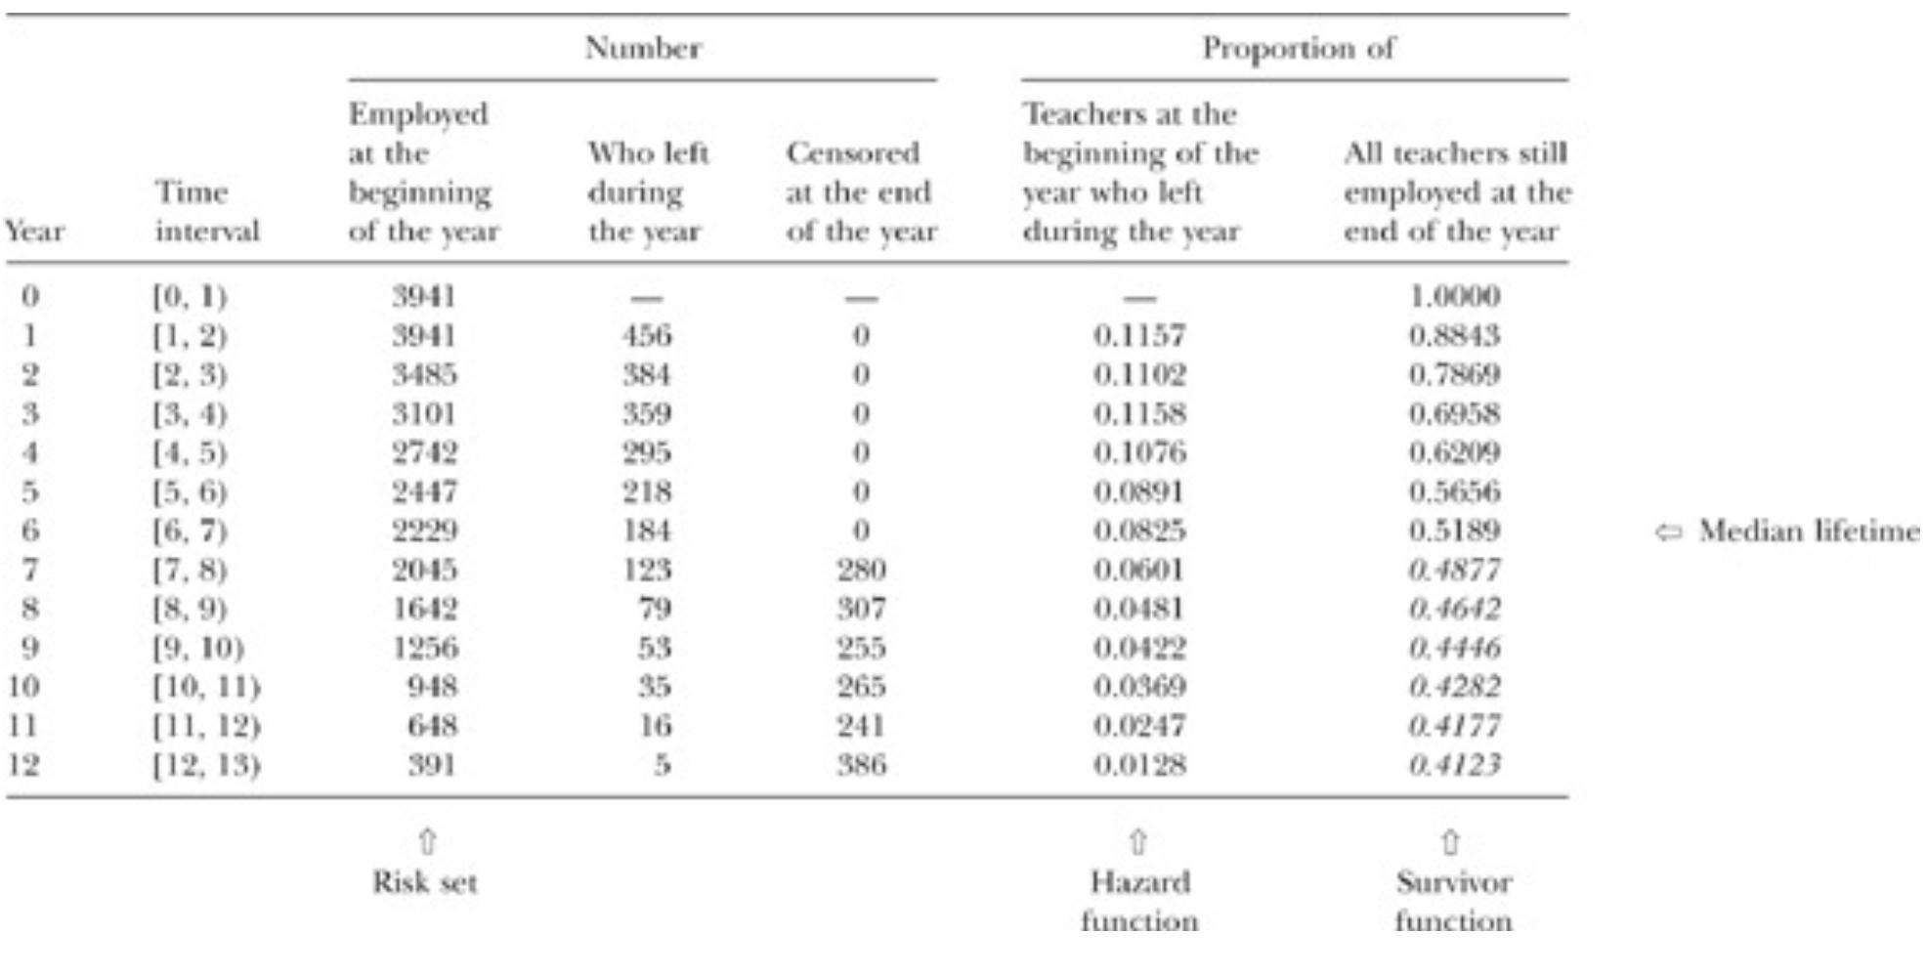
An example of a life table, which summarizes the sample distribution of event data, from Singer & Willett (2010) Table 10.1. The event of interest is quitting a teaching job

Slide 22
Teachers hired between 1972 and 1978 were observed until 1985 (12 year window, by year).

Slide 23
Years that a teacher was employed, where 0 = year of hire. Max number of observable years is 12, which was only obtainable by those hired in 1972.

Slide 24
Number of teachers employed at the beginning of a given year

Slide 25
Number of teachers who quit during a given year

Slide 26
Number of teachers whose data were censored. This starts at the 7th year of the study (1978), which is when those hired in 1978 began.

Slide 27
The proportion of teachers who left during a given year, which is the basis of the hazard function. Highest risk of quitting is in the first few years.

Slide 28
The proportion of teachers who were still teaching by a certain year, which is the basis of the survival function. Drops quickly in the first few years.

Slide 29
“Median lifetime” is a measure of central tendency in survival analysis. It’s the point at which the estimated survival function equals 50%.

Slide 30
Survival analysis - exercise
In your groups, review Question 5 in Problem Set 8.
Make sure to execute all of the code first, then answer the questions that follow.
Bonus question! Given the plot you see in the third code chunk, do you think the fitted model adequately models the time-to-event?

